Slide 1
Open Source Software Development Project
The Internator: A web app that will help interns manage their hours, pay and day-to-day activities
Name: Madhumeta Ganesh

Slide 2
Intended Users: interns mainly but part-time and full-time employees could use it too
License: MIT License
Github repo: https://github.com/madhu-ganesh/TheInternator
Contact info (to learn more or report bugs): mganesh@pdx.edu

Slide 3
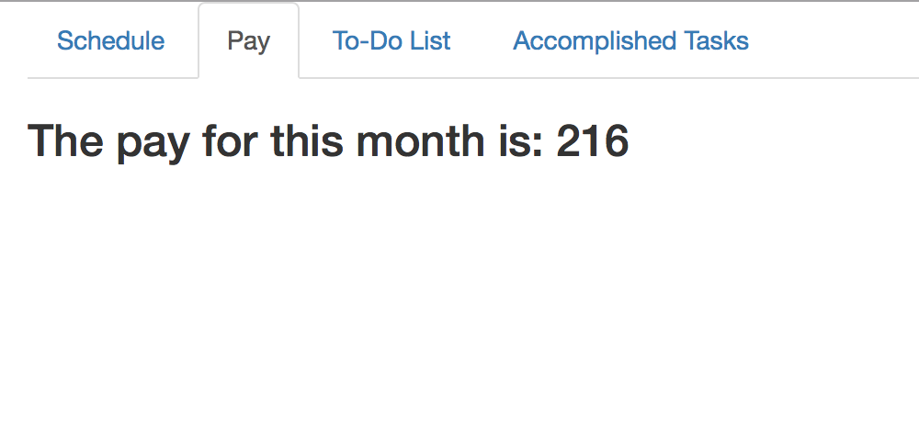
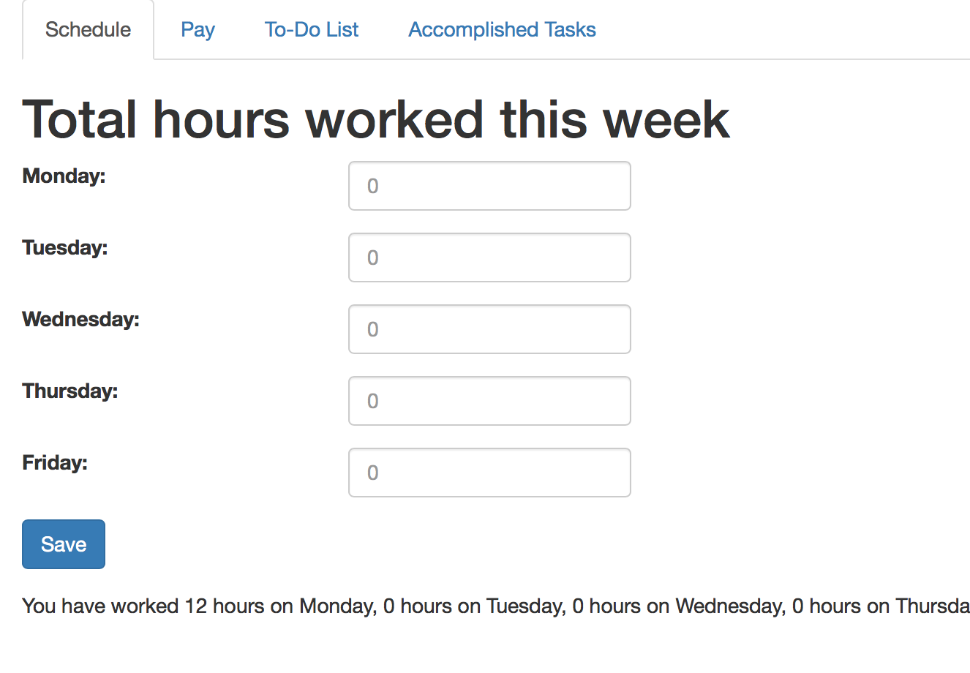
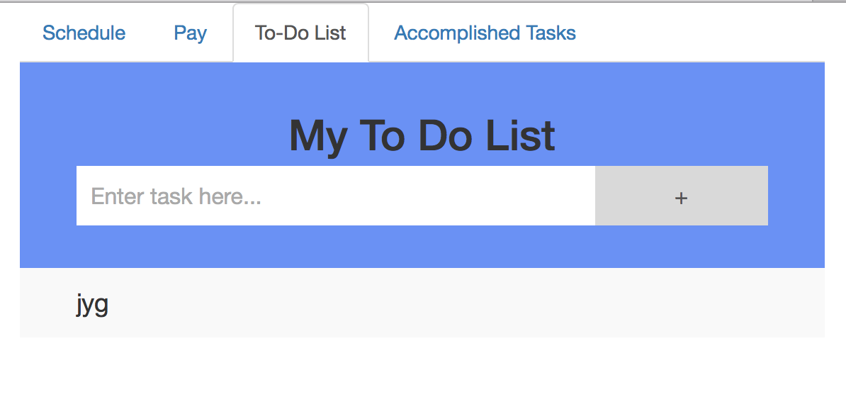
The “Old” Look

Slide 4
Key Features
The application will record how many hours the user has worked so far in the week and give suggestions of when he/she could complete the remaining hours (this will be done by synching his/her Google calendar with the app to know free timings, class schedule, etc).
It will calculate my paychecks and alert user when it is payday.
It will have a “To-Do” list of what issues user need to solve for the next day/next week and will have the ability to mark items that are completed on that list and/or add small notes to them.
As the user marks items he/she has completed, they will populate the “Accomplished tasks for the week” list which can be used as a report for the weekly meeting.

Slide 5
Tools used…
Frontend done with Bootstrap, basic HTML + CSS
Backend done with Node.js, Express and SQLite database

Slide 6
Compared to what’s out there and future improvements
Many apps with variations of these features or extensions
I wanted one which had it all combined in one app. For now, it is not very extensive if you look at each feature on its own but for future work, I plan to expand on each with login, sending email functionality, having deadlines for tasks, team formation, etc.

Slide 7
Successes and Failures
Was able to make the app responsive
Give it a whole new look with much smoother transition between tabs
Was able to push things from database to the application
Alert when it is payday
Able to save tasks to and load tasks from database
Midway through syncing with Google Calendar API
Keep hitting io.on(‘connection’) code multiple times
Need to implement a settings tab to make information more dynamic and user-friendly
Spent too much time on the design and feel so could not work on optional features

Slide 8


